Slide 1



Winter Camp 2024
Java Programming
Session 7
Wrapper Classes and Collection-List
Prepared by: Faculty 4.0 Team

Slide 2
Contents
1
3
Wrapper Classes
ArrayList
2
Collection-List
4
Problem Solving

Slide 3
Wrapper Classes

Slide 4

Wrapper Classes
For all the primitive data types available in Java, there is a corresponding Object representation available which is known as Wrapper Classes.

Slide 5
Wrapper Classes
To declare an integer ‘i’ holding the value 10, you write
int i = 10;
The object representation of integer ‘i’ holding the value 10 will be:
Integer iref = new Integer(i);
Here, class Integer is the wrapper class wrapping a primitive data type i

Slide 6
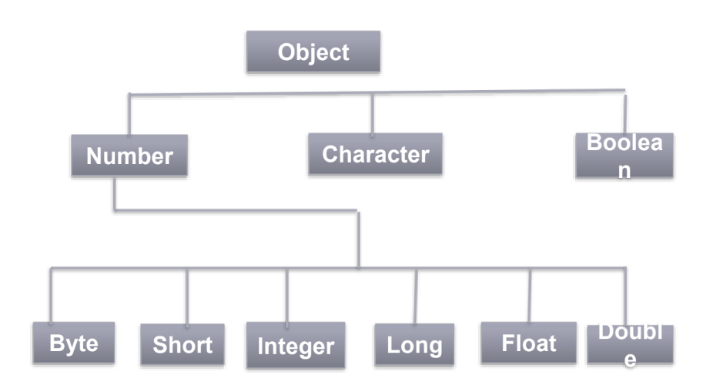
Wrapper Classes in JAVA

Slide 7
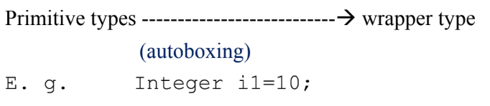
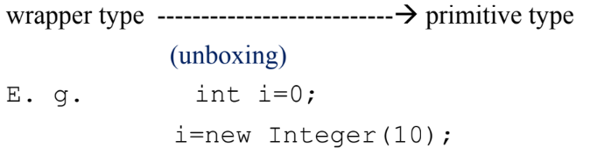
Autoboxing and Unboxing

Slide 8
Integer Wrapper Class
The Integer class in Java is a wrapper class that wraps a value of the primitive type int in an object.
Example:
Integer x=25;//boxing
int i=10;
Integer x=i;//boxing

Slide 9
Integer Wrapper Class-Methods
The parseInt() method in Java is used to change numbers that are written as text (strings) into actual numbers (integers) that the computer can understand and work with.
public static int parseInt (String s)
public static int parseInt (String s, int radix)
String str = "149";
int num = Integer.parseInt(str);
int num1 = Integer.parseInt(str,16);
System.out.println(num + 3); // This will print 152
System.out.println(num1); //329

Slide 10
Integer Wrapper Class-Methods
public static int bitCount(int i)
public static String toBinaryString (int i)
public static String toHexString (int i)
public static String toOctalString (int i)
int n = 35;
// Conversion of integer number to binary format
System.out.println(Integer.toBinaryString(n)); //100011
// Print number of 1's in the number n
System.out.println(Integer.bitCount(n)); //3

Slide 11
Integer Wrapper Class-Methods
public String toString()
public static String toString(int i)
Integer obj = 25;
String strval1 = obj.toString();
System.out.println("Output: "+Integer.toString(-12));

Slide 12
Integer Wrapper Class-Methods
public static int compare(int x,int y)
public int compareTo(Integer anotherInteger)
int num1 = 10;
int num2 = 20;
// as num1 less than num2, Output will be less than zero
System.out.println(Integer.compare(num1, num2));
Integer num1 = new Integer(10);
Integer num2 = new Integer(20);
System.out.println(num1.compareTo(num2));

Slide 13
Integer Wrapper Class-Methods
public double doubleValue()
This method returns the value of this Integer as a double equivalent.
Similarly we have other methods too,
public int intValue()
public abstract float floatValue()
public int longValue()

Slide 14
Integer Wrapper Class-Methods
public static int sum(int a, int b)
public static long sum(long a, long b)
public static float sum(float a, float b)
public static double sum(double a, double b)
int a = 65;
int b = 35;
System.out.println("The sum of a and b is = " + Integer.sum(a, b));

Slide 15
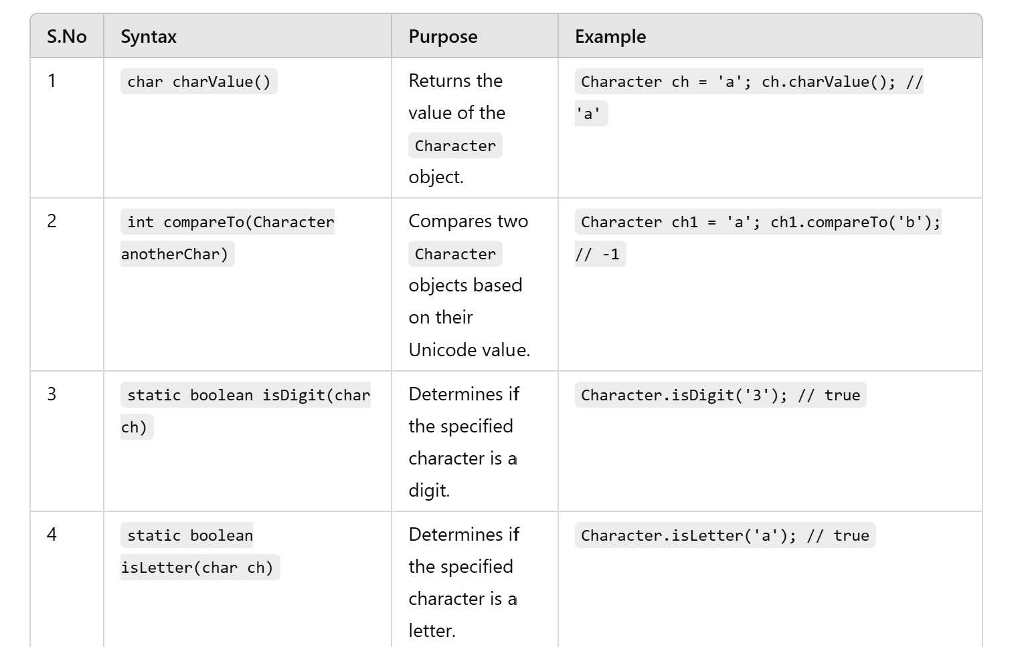
Character Wrapper Class

Slide 16
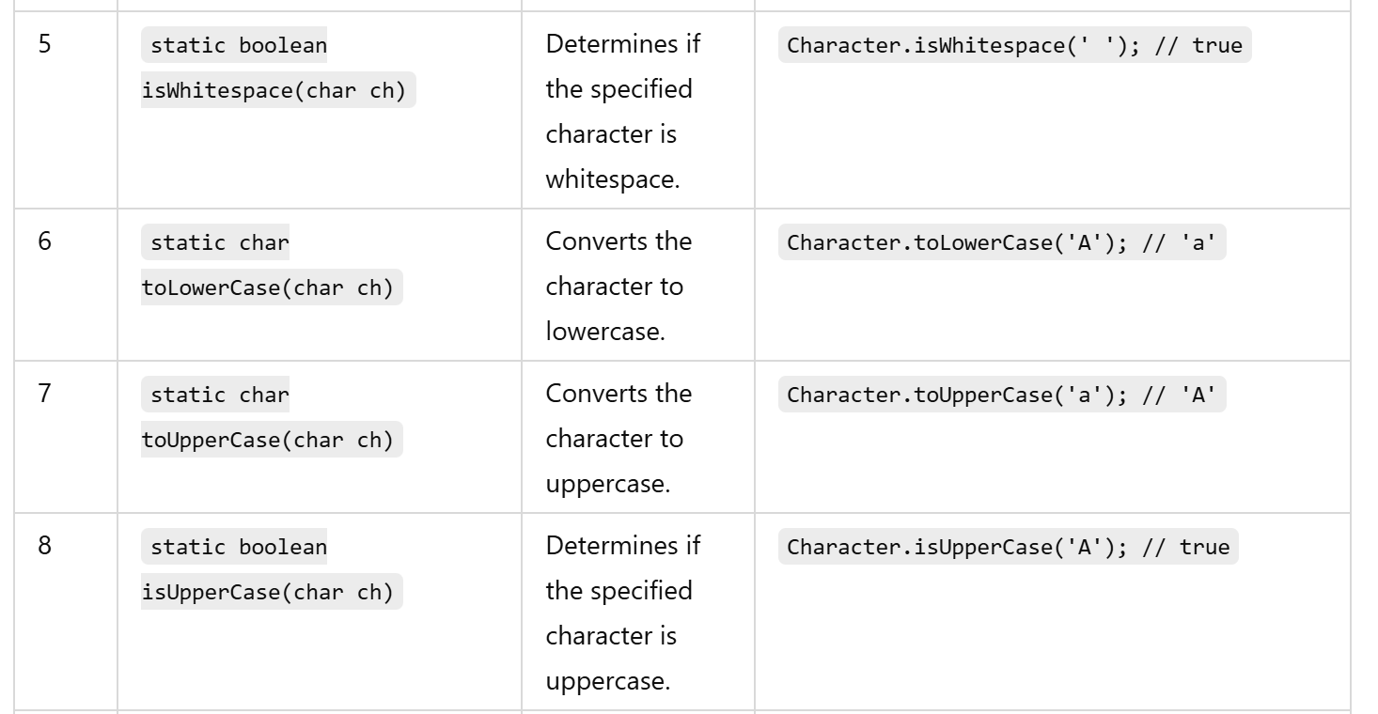
Character Wrapper Class

Slide 17
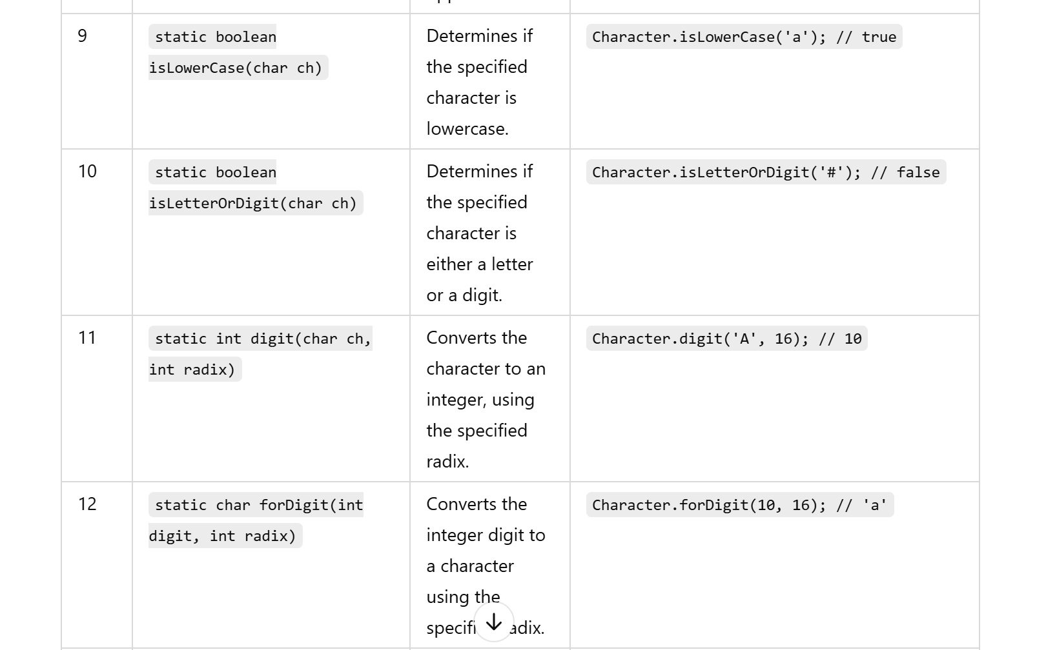
Character Wrapper Class

Slide 18
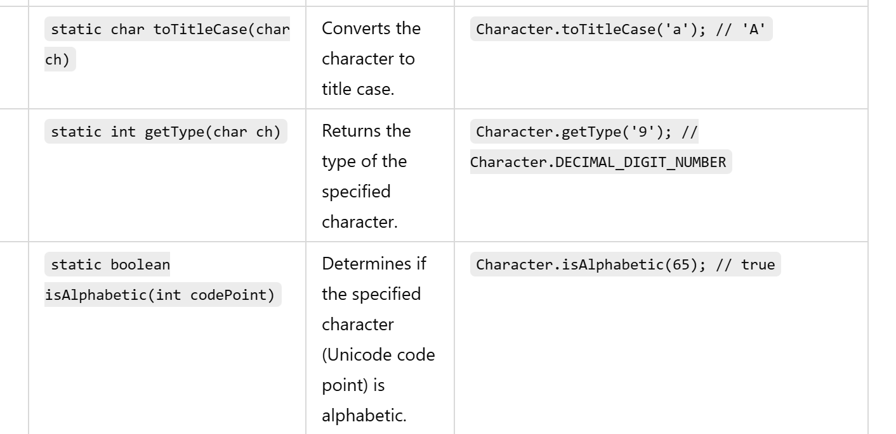
Character Wrapper Class

Slide 19

Problem Statement 1
Develop a Java program that converts a hexadecimal string into its decimal equivalent using the Integer wrapper class. The program should validate that the input is a valid hexadecimal string before conversion. If invalid, the program should notify the user of the error.
Input Format:
A hexadecimal number as a string.
Output Format:
Decimal equivalent of the hexadecimal number or an error message if the input is invalid.
Example:
Input
1A3F
Output
6719

Slide 20
Solution
public class HexadecimalToDecimal {
public static void main(String[] args) {
String hexInput = "1A3F"; // Example valid input
// String hexInput = "GHIJ"; // Example invalid input
boolean isValid = true;
for (char ch : hexInput.toCharArray()) {
if (!(Character.isDigit(ch) || (Character.toUpperCase(ch) >= 'A' && Character.toUpperCase(ch) <= 'F'))) {
isValid = false;
break;
}
}
if (isValid) {
int decimalOutput = Integer.parseInt(hexInput, 16);
System.out.println(decimalOutput);
} else {
System.out.println("Error: Invalid hexadecimal input.");
}
}
}

Slide 21
Collection

Slide 22
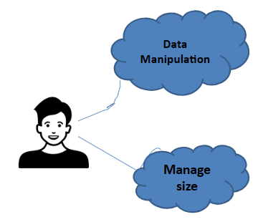
Collection Framework
We can use arrays to store items of the same type.
The main issue with arrays is that they have to be manually sized before use(fixed size).
So we Need a mechanism to manipulate and manage data more efficient and fast.
Collection-Data Structure

Slide 23
Collection Framework
The Java Collections Framework is a set of classes and interfaces that implement commonly reusable collection data structures.
The framework is designed to allow Java developers to manage collections of objects efficiently and easily with high-level data structures.

Slide 24
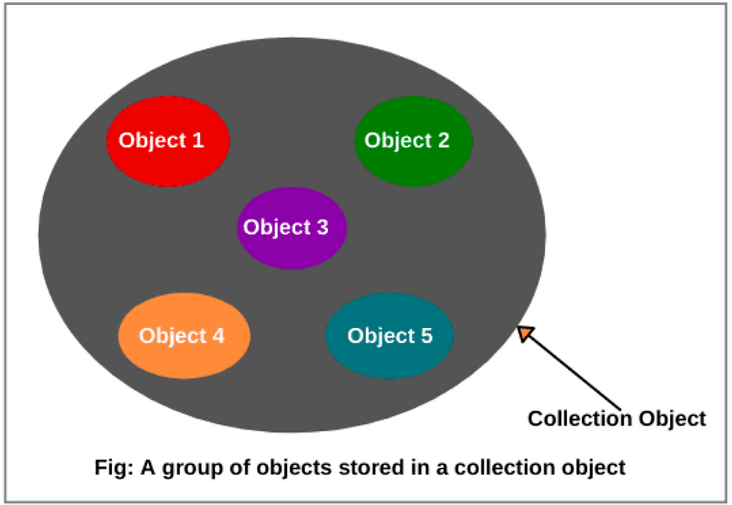
What is a Collection?
A “collection” is a container that groups multiple elements into a single unit.
A collection represents a group of objects.
Collections serve as the foundation for storing, retrieving, manipulating, and communicating aggregate data. Typically, they provide a more abstract and higher level approach to data handling compared to arrays.

Slide 25
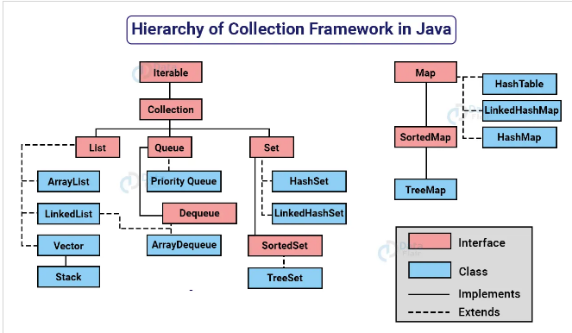

Slide 26
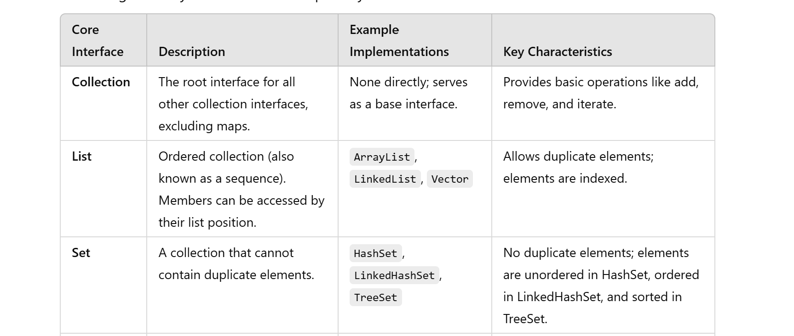
Core Interfaces

Slide 27
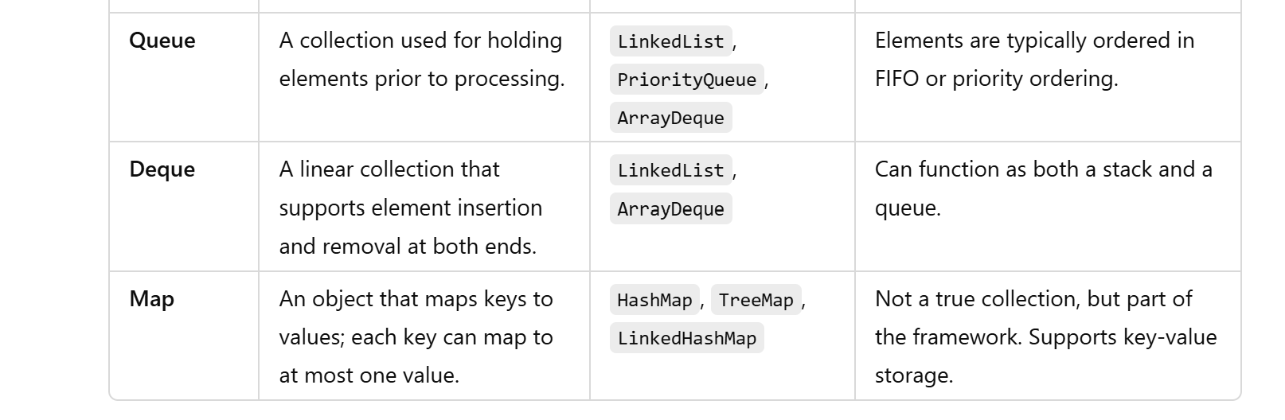
Core Interfaces

Slide 28
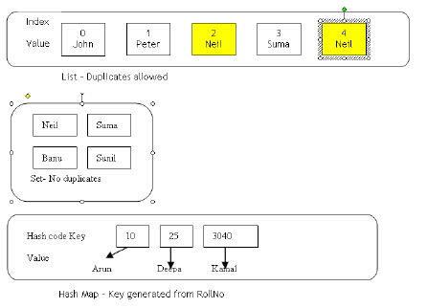
Illustration of List, Set and Map

Slide 29
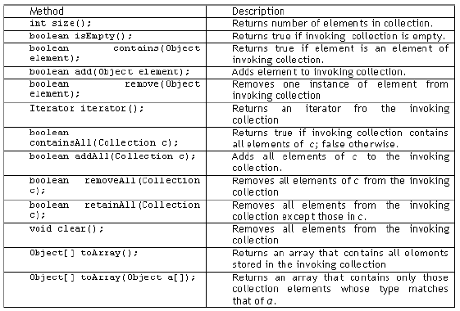
Collection Interface-Methods

Slide 30
Collection-List

Slide 31
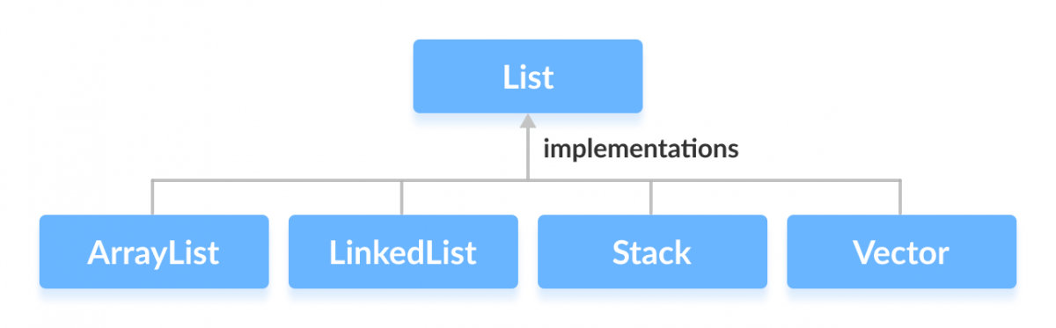
List Interface
Used for storing the elements in a ordered way.
Supports duplicate entries.
Supports index-based additions and retrieval of items.

Slide 32
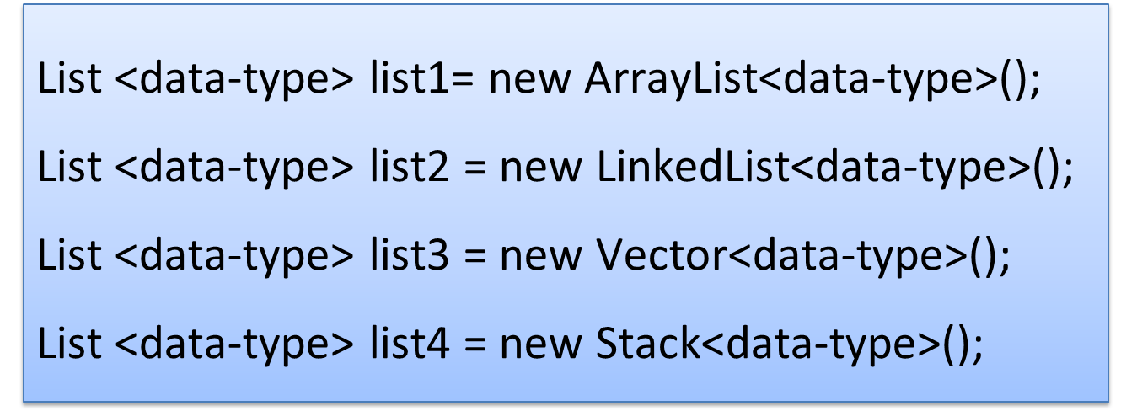
List Instance Creation

Slide 33
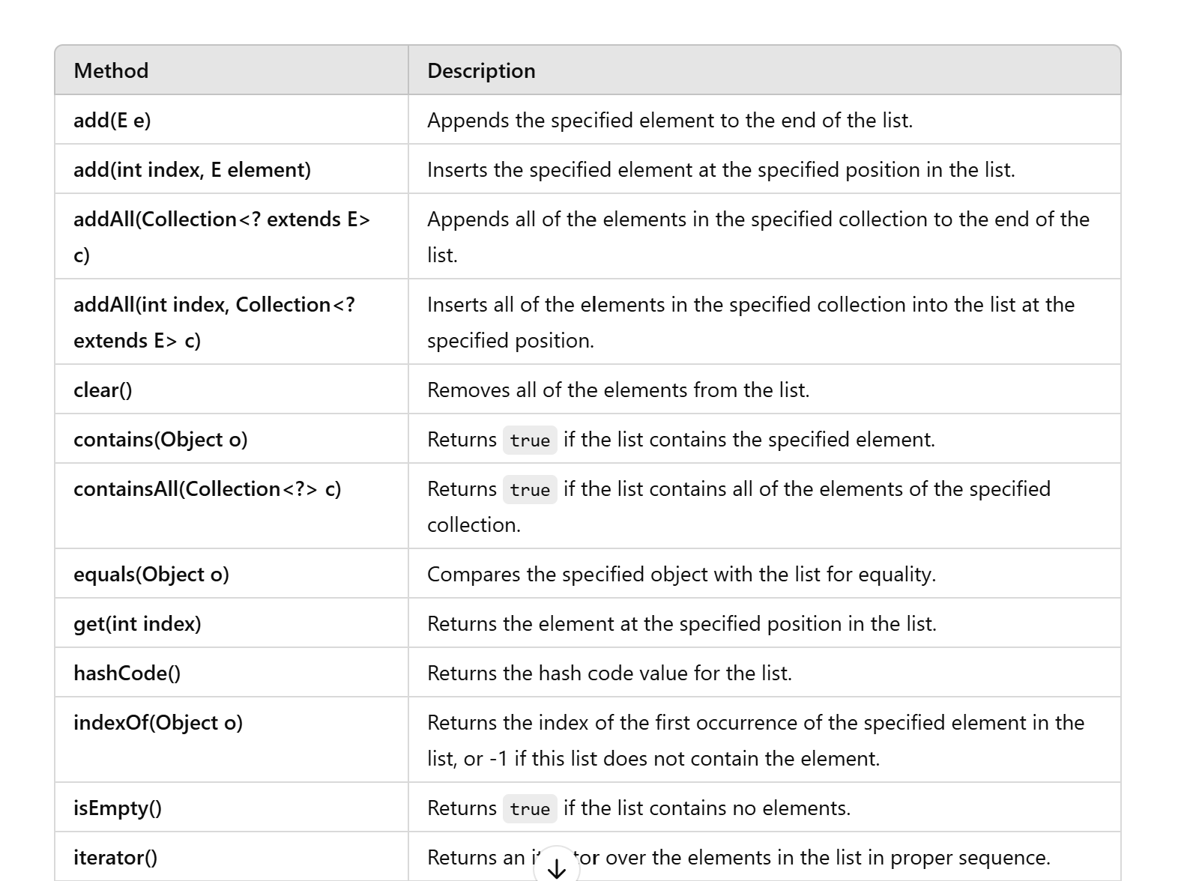
List Interface Methods

Slide 34
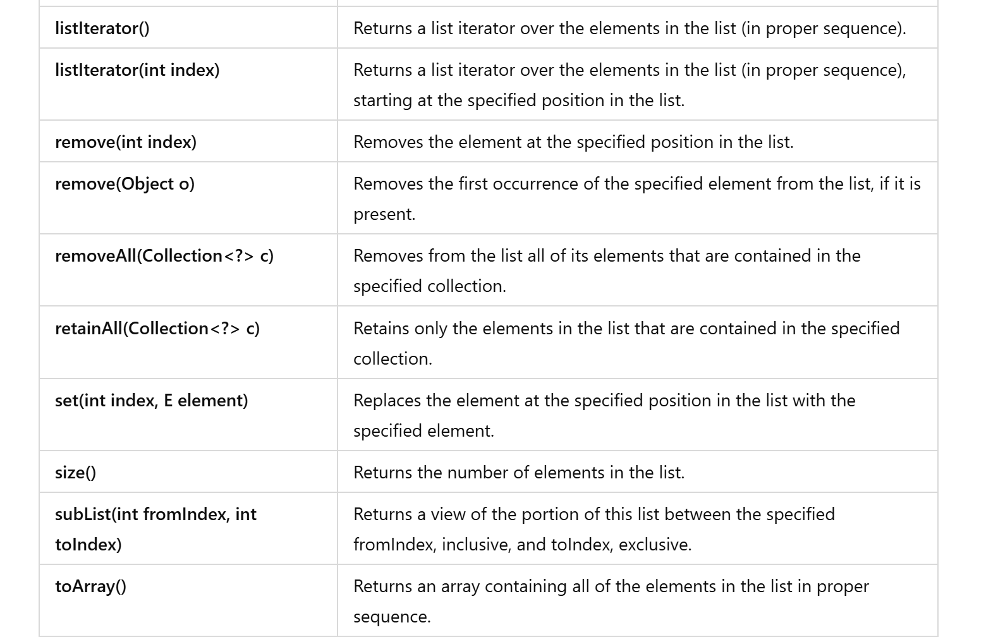
List Interface Methods

Slide 35
Arraylist

Slide 36
ArrayList
Implements List interface
ArrayList can grow and shrink in size dynamically based on the elements stored hence can be considered as a variable array.
Values are stored internally as an array hence random insert and retrieval of elements are allowed.
Can be traversed using a foreach loop, iterators, or indexes.
Initially gets created with an initial capacity , when this get’s filled the list automatically grows.
Can hold only object type data – Cannot hold primitive type values.
Supports duplicate entries.

Slide 37
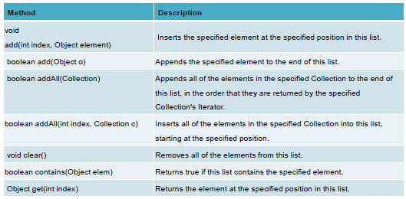
ArrayList-Important Methods

Slide 38
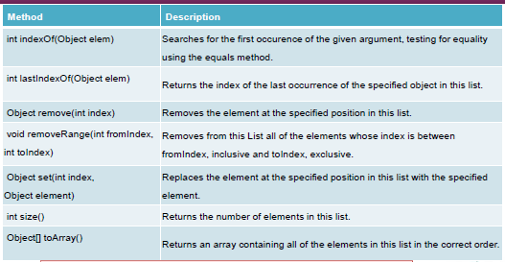
ArrayList-Important Methods

Slide 39
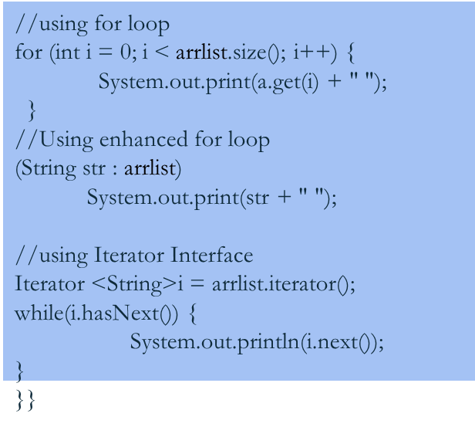
ArrayList-Example
import java.util.*;
public class Test {
public static void main(String[] args) {
//Creating an ArrayList object
ArrayList<String>arrlist = new ArrayList<String>();
//Adding elements to ArrayList object
arrlist.add("Apple");
arrlist.add("Amazon");
arrlist.add("Facebook");
arrlist.add("Google");
arrlist.add("IBM");
arrlist.add("Tesla");

Slide 40
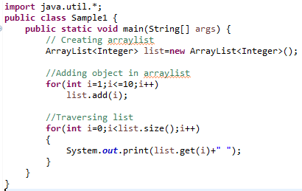
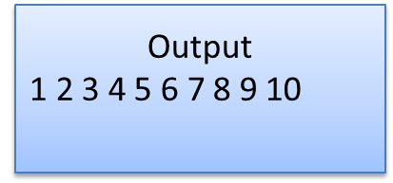
ArrayList-Example

Slide 41
Linkedlist

Slide 42
LinkedList
The LinkedList class in Java is a concrete implementation of the List and Deque interfaces, providing a doubly-linked list data structure.
It offers efficient operations for adding, removing, and accessing elements, particularly when operations are performed at the head or tail of the list, making it an excellent choice for implementing stacks, queues, or double-ended queues (deques).
Maintains insertion order.
Manipulation is fast because no shifting needs to occur.

Slide 43
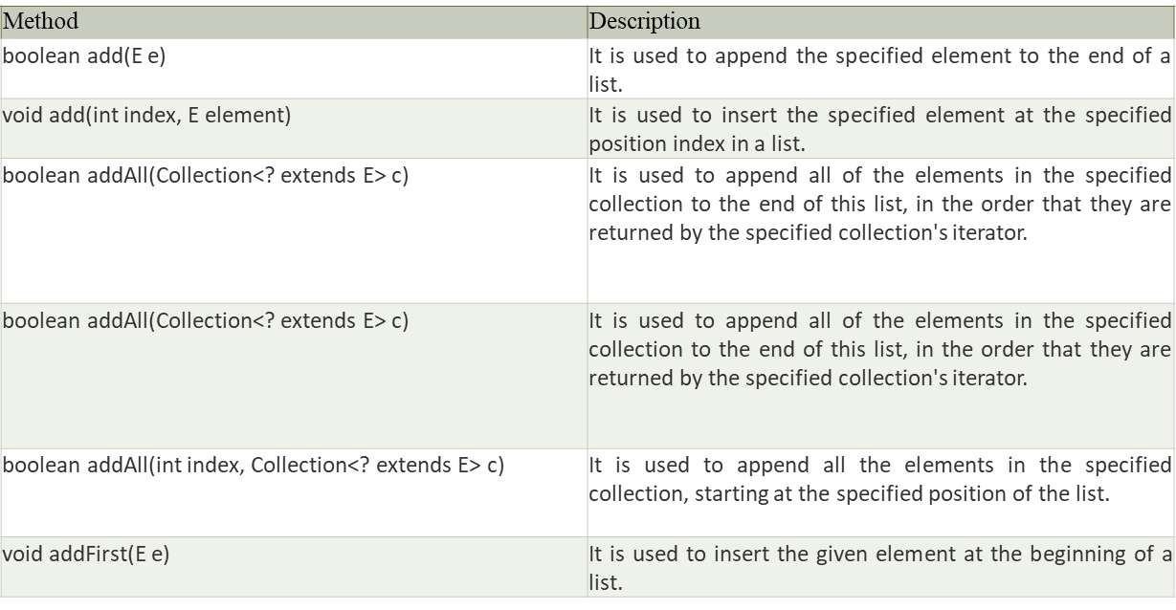
LinkedList-Important Methods

Slide 44
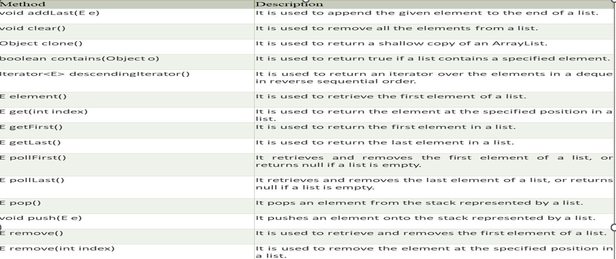
LinkedList-Important Methods

Slide 45
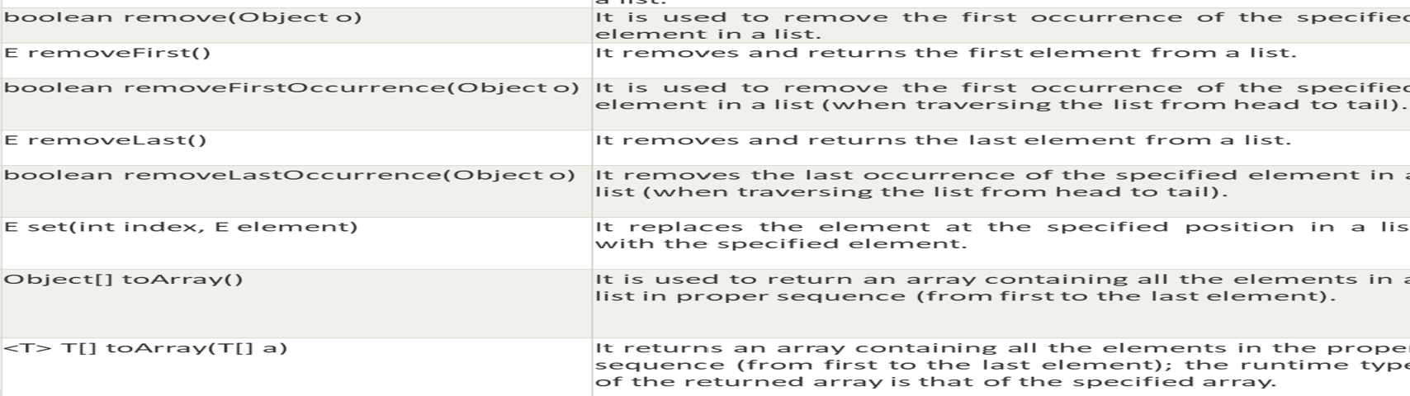
LinkedList-Important Methods

Slide 46
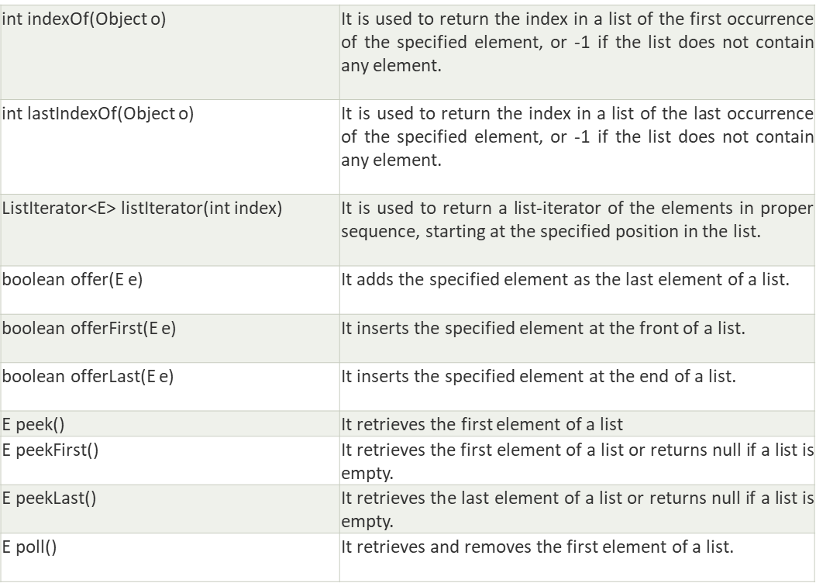
LinkedList-Important Methods

Slide 47
Collections Class

Slide 48
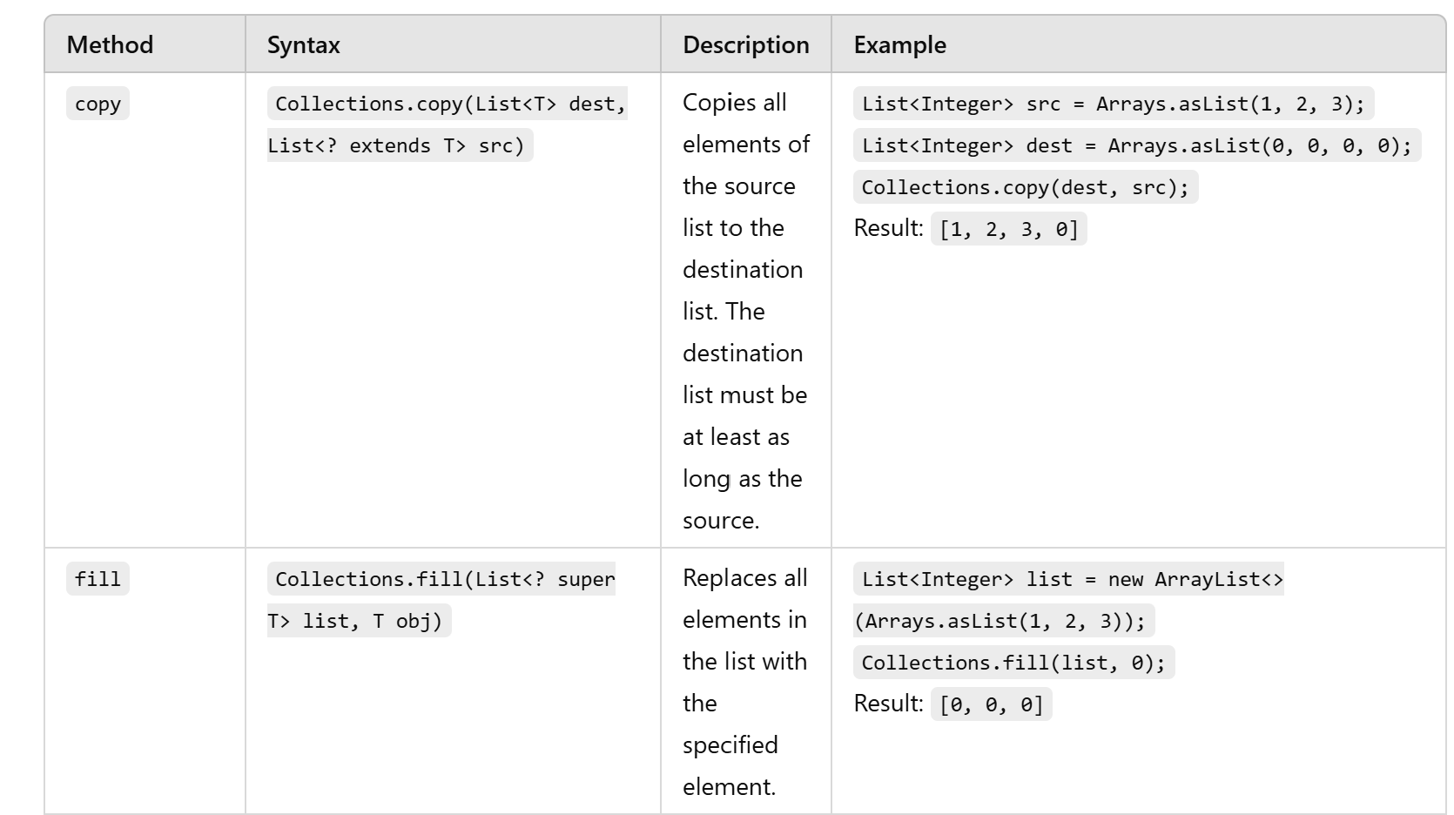
Collections Class
Java collection class is used exclusively with static methods that operate on or return collections. It inherits Object class.

Slide 49
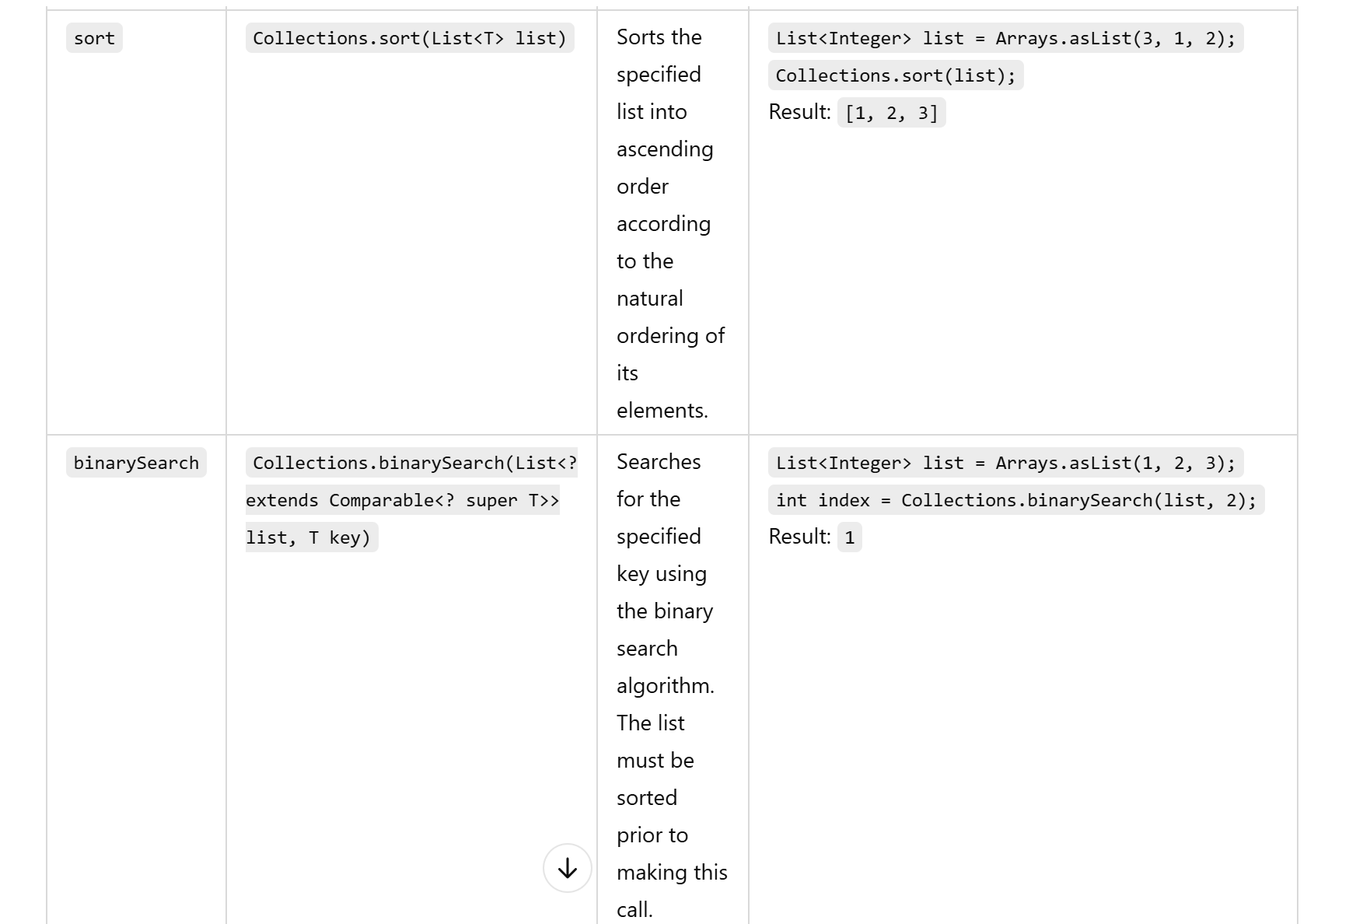
Collections Class-methods

Slide 50
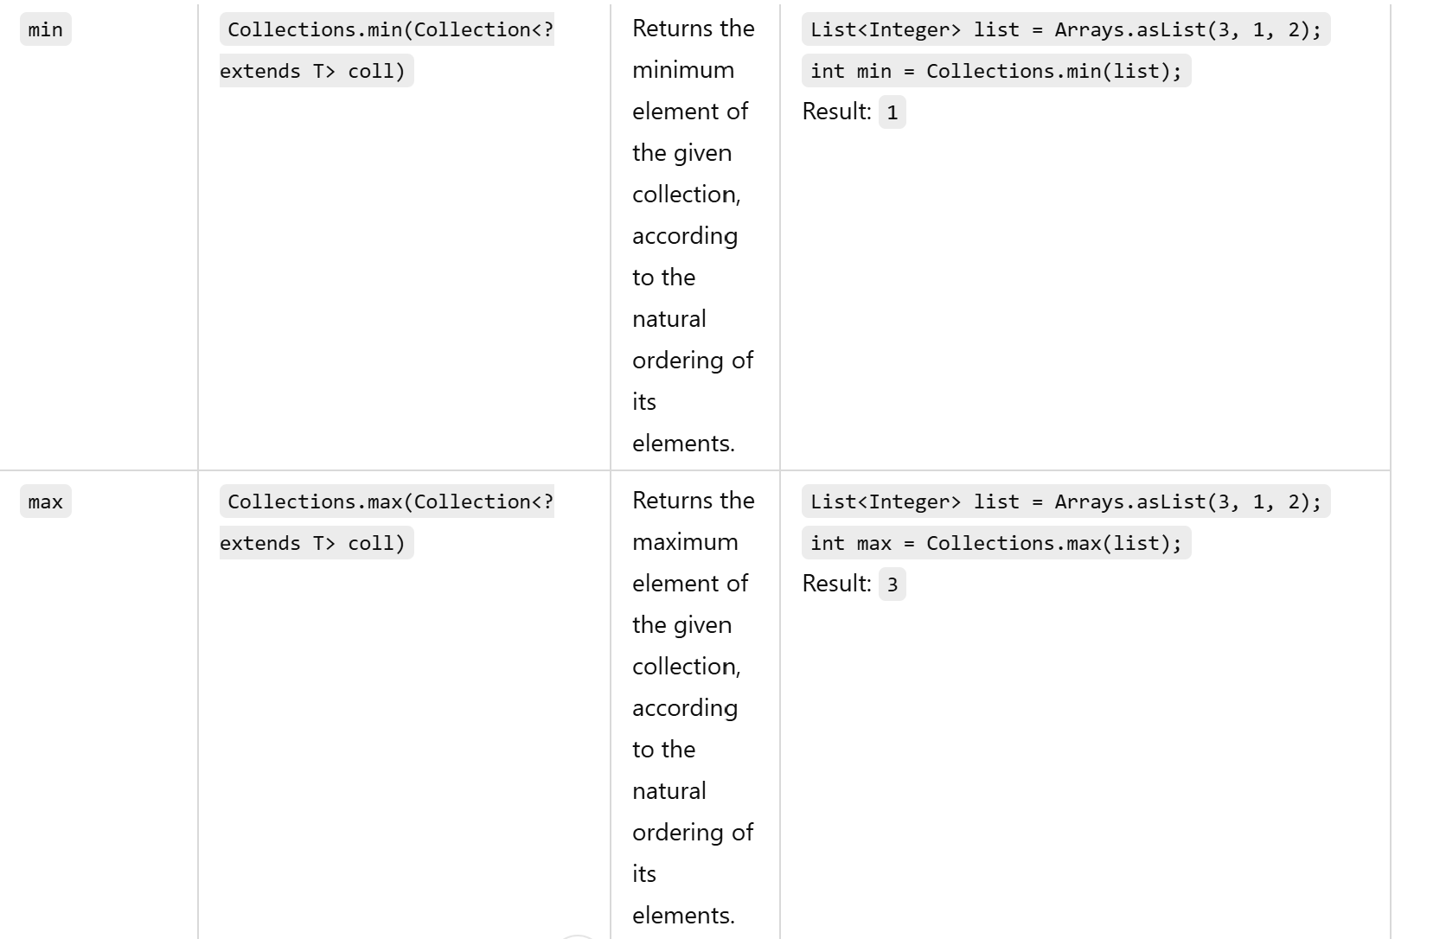
Collections Class-methods

Slide 51
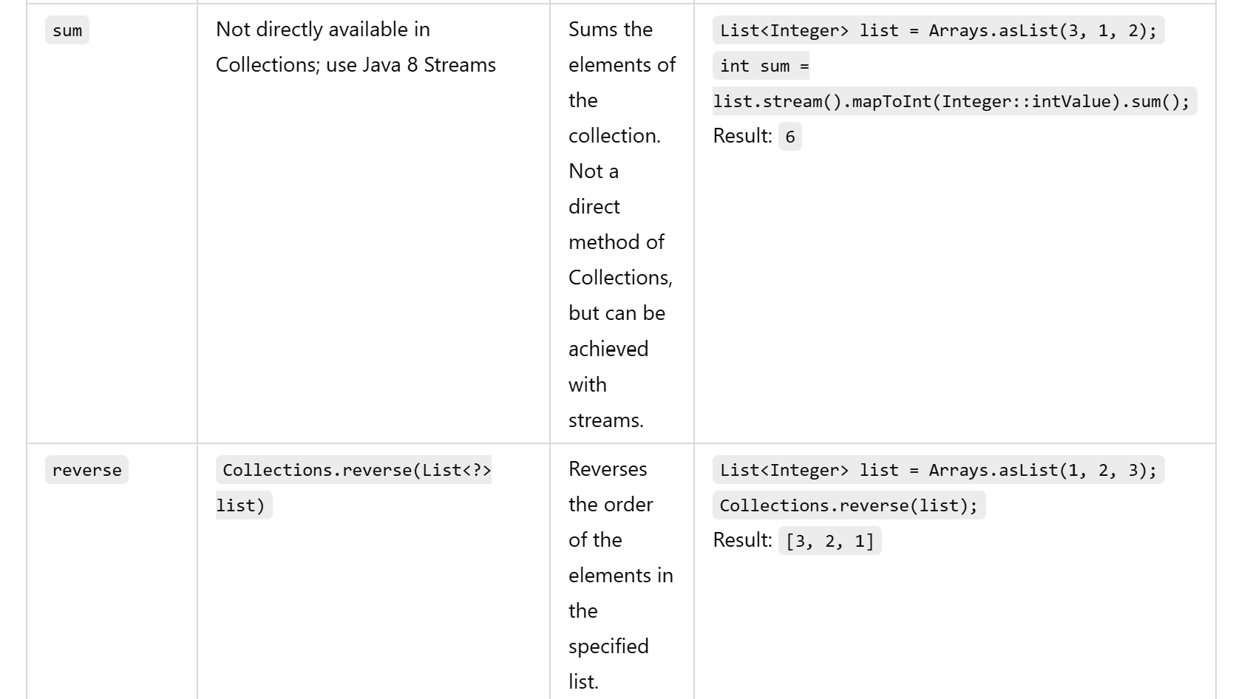
Collections Class-methods

Slide 52
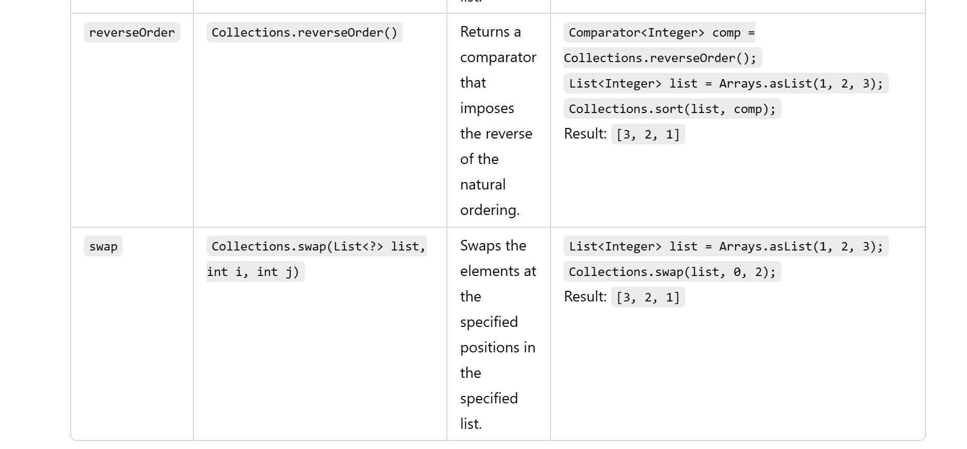
Collections Class-methods

Slide 53
Problem Solving

Slide 54
Problem Statement 1
Task: An investor opens a new account and wants to invest in a number of assets. Each asset begins with a balance of 0, and its value is stored in an array using 1-based indexing. Periodically, a contribution is received and equal investments are made in a subset of the portfolio.
Each contribution will be given by investment amount, start index, end index. Each investment in that range will receive the contribution amount. Determine the maximum amount invested in any one investment after all contributions.

Slide 55
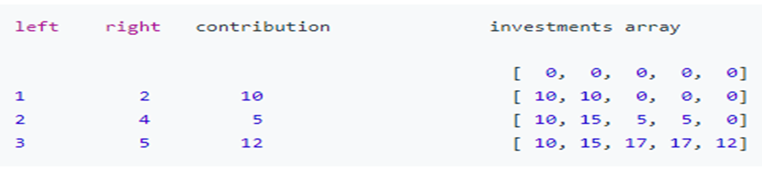
Problem Statement 1
For example, start with an array of 5 elements (n = 5): investments = [0, 0, 0, 0, 0]. The variables left and right represent the starting and ending indices, inclusive. Another variable, contribution, is the new funds to invest per asset. The first investment is at index 1.
In the first round, a contribution of 10 is made to investments 1 and 2. In the second round, a contribution of 5 is made to assets 2, 3 and 4. Finally, in the third round, a contribution of 12 is added to investments 3, 4 and 5. The maximum invested in any one asset is 17

Slide 56

Solution
for(int c=0;c<3;c++){
l=sc.nextInt();
r=sc.nextInt();
con=sc.nextInt();
for(int k=l-1;k<r;k++)
l1.set(k,l1.get(k)+con);
}
System.out.println(Collections.max(l1));
}
}
import java.util.*;
public class MyClass {
public static void main(String args[]) {
Scanner sc=new Scanner(System.in);
ArrayList<Integer> l1=new ArrayList<Integer>();
int n=sc.nextInt();
for(int i=0;i<n;i++){
l1.add(0);
}
int l,r,con;

Slide 57
Problem Statement 2
While entering user names, We have to be very careful about the duplicate entries in the list.
To make a correct and perfect report, we have to remove the duplicate elements in the list. Write a program that obtain a set of names and a search element and print it’s frequency.
Input Format :
The first line of the input consists of the number of names.
Next input is the user names.
The last input is the user name to be searched.

Slide 58
Problem Statement 2
Output Format :
The output prints the frequency of the searched element.
Sample testcases :
Testcase 1 Input
5
alice
bob
ankit
alice
prajit
alice
Testcase 1 Output
2

Slide 59
import java.util.ArrayList;
import java.util.Scanner;
public class UserNameFrequency {
public static void main(String[] args) {
Scanner scanner = new Scanner(System.in);
// Read the number of names
int numberOfNames = Integer.parseInt(scanner.nextLine());
// Create an ArrayList to store all names
ArrayList<String> names = new ArrayList<>();
// Read names and add them to the list
for (int i = 0; i < numberOfNames; i++) {
String name = scanner.nextLine();
names.add(name);
}
// Read the search element
String searchName = scanner.nextLine();
// Count the frequency of the search element
int frequency = 0;
for (String name : names) {
if (name.equals(searchName)) {
frequency++;
}
}
// Print the frequency of the search name
System.out.println(frequency);
scanner.close();
}}

Slide 60
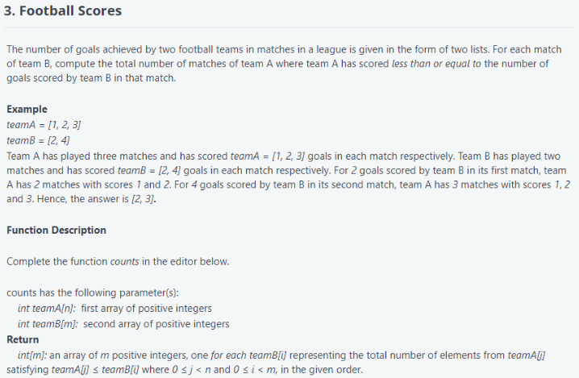
Problem Statement 2

Slide 61
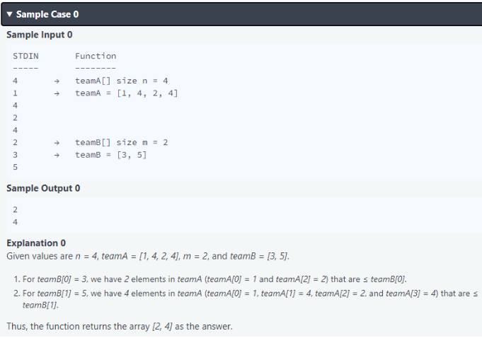
Problem Statement 2

Slide 62
Solution
int m=sc.nextInt();
for(int i=0;i<m;i++){
TB.add(sc.nextInt());
}
Collections.sort(TA);
for(int i=0;i<m;i++){
int index= Collections.binarySearch(TA,TB.get(i));
ans.add(Math.abs(index+1));
}
System.out.println(ans);
}
}
import java.util.*;
public class MyClass {
public static void main(String args[]) {
ArrayList<Integer> TA=new ArrayList<Integer>();
ArrayList<Integer> TB=new ArrayList<Integer>();
ArrayList<Integer> ans=new ArrayList<Integer>();
Scanner sc=new Scanner(System.in);
int n=sc.nextInt();
for(int i=0;i<n;i++){
TA.add(sc.nextInt());
}

Slide 63
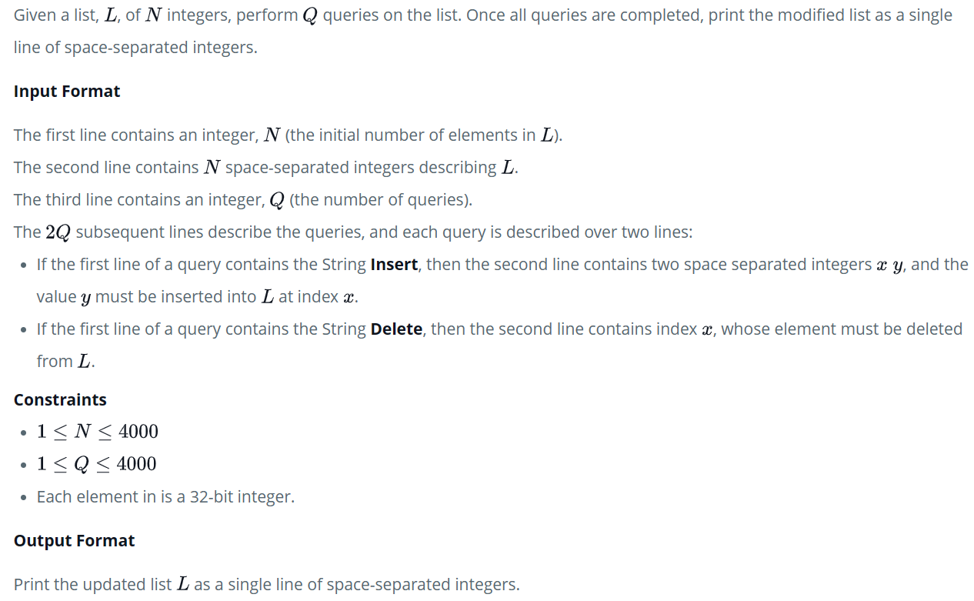
Problem Statement 4

Slide 64
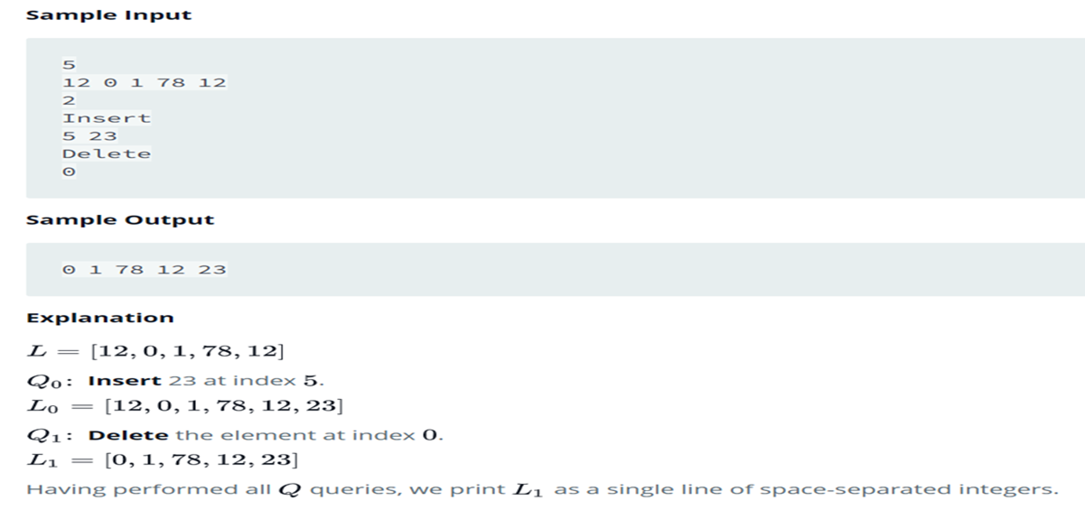
Problem Statement 3

Slide 65
Solution
for(int i=0;i<m;i++){
String s = sc.next();
if (s.equals("Insert")) {
int a = sc.nextInt();
int b = sc.nextInt();
list.add(a, b);
} else {
int x = sc.nextInt();
list.remove(x);
}
}
for (Integer i : list) {
System.out.print(i+" ");
}
}
}
import java.util.*;
class HelloWorld {
public static void main(String[] args) {
List<Integer> list = new LinkedList<>();
Scanner sc = new Scanner(System.in);
int n = sc.nextInt();
for(int i=0;i<n;i++){
list.add(sc.nextInt());
}
int m = sc.nextInt();

Slide 66
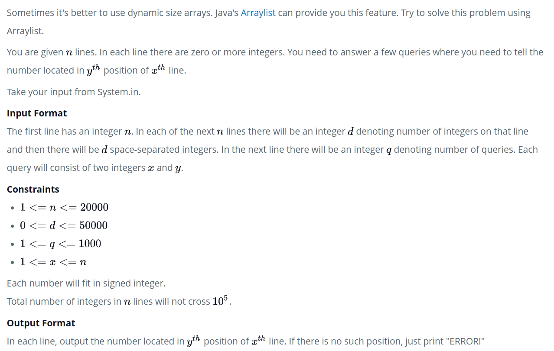
Problem Statement 4

Slide 67
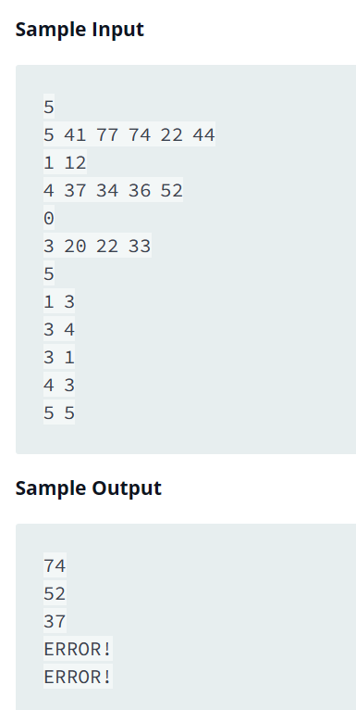
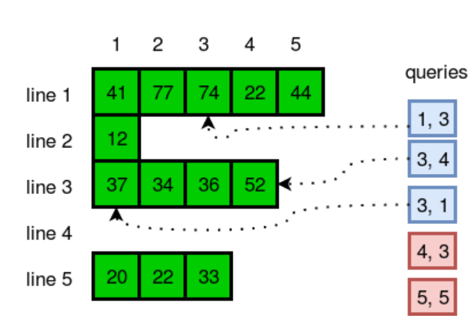
Problem Statement 4

Slide 68
Solution
/* Answer the queries */
int q = scan.nextInt();
for (int i = 0; i < q; i++) {
int x = scan.nextInt();
int y = scan.nextInt();
ArrayList<Integer> list = lists.get(x-1);
if (y <= list.size()) {
System.out.println(list.get(y-1));
} else {
System.out.println("ERROR!");
}
}
import java.util.*;
class HelloWorld {
public static void main(String[] args) {
Scanner scan = new Scanner(System.in);
int n = scan.nextInt();
/* Save numbers in 2-D ArrayList */
ArrayList<ArrayList<Integer>> lists = new ArrayList();
for (int row = 0; row < n; row++) {
int d = scan.nextInt();
ArrayList<Integer> list = new ArrayList();
for (int col = 0; col < d; col++) {
list.add(scan.nextInt());
}
lists.add(list);
}

Slide 69
Thank you!

